Slide 2
Syllabus
Introduction
An Informal Example
The family of attributive languages
Concept descriptions
Terminologies
Assertions
Inference problems
Inference problems for concept descriptions
Inference problems for assertions.

Slide 3
Introduction
Knowledge Representation means representing information about the world in a form that a computer system can utilize to solve complex tasks.
Description logic denotes a family of knowledge representation formalisms that model the application domain by defining the relevant concepts of the domain and then using these concepts to specify properties of objects and individuals occurring in the domain.
Description logic received renewed attention recently because it provides a formal framework for the Web ontology language OWL, proposed as a standard.

Slide 4
Introduction
Description Logic Knowledge Representation formalisms are categorized into two groups.
Non-Logic based formalisms
Logic-based formalisms
The Non-Logic based formalisms reflect cognitive notions and claim to be closer to one’s intuition.
Such formalisms include semantic networks, frames, and rule-based representations, However, most of them lack a consistent semantics and adopt ad hoc reasoning procedures, which leads to systems that exhibit different behavior.

Slide 5
Introduction
The Logic-based formalisms includes those formalisms that are variants of first-order logic.
They reflect the belief that first order logic is sufficient to describe facts about the real world, because they borrow the basic syntax, semantics, and proof theory of first-order logic.
Semantic networks and frames were later given a formal semantics by mapping them to first-order logic.

Slide 6
Introduction
Knowledge Representation systems can be characterized as
Pre-DL systems
DL systems
Current generation DL systems
In general, pre-DL systems were mainly concerned with concept representation schemes and classification algorithms.
DL systems were inspired by theoretical research on the complexity of reasoning in description logic.(Ex: CLASSIC, BACK)
Current generation DL systems, of which FACT and RACER are good examples, use optimized reasoning techniques to deal with expressive varieties of description logic and yet retain completeness.

Slide 7
An Informal Example
The following requirements largely shaped the development of description logic:
The description language should support the notions of:
Atomic concepts (denoting sets of individuals)
Atomic roles (denoting binary relations between individuals)
Constants (denoting individuals)
The description language should include constructors to define:
Complex concepts (denoting sets of individuals)
Complex roles (denoting binary relations between individuals)
Axioms (defining new concepts or imposing restrictions on the concepts)
Assertions (expressing facts about individuals)

Slide 8
An Informal Example
The reasoning techniques should cover at least:
Concept subsumption (a concept is a subconcept of another concept)
Concept instantiation (an individual is an instance of a concept)
We use the few constructions of description logic to describe our example where C and D are complex concepts, R is an atomic role, and a and b are constants denoting individuals

Slide 9
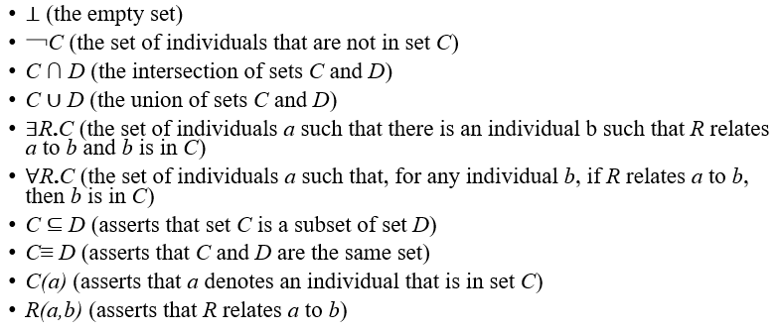
An Informal Example

Slide 10
An Informal Example
The intuitive meaning of all these constructs is immediate, except for ∃R.C and ∀R.C, which are given special attention in the examples that follow.
Consider an alphabet consisting of the atomic concepts, atomic roles, and constants (together with their intended interpretation) represented in next slide.

Slide 11
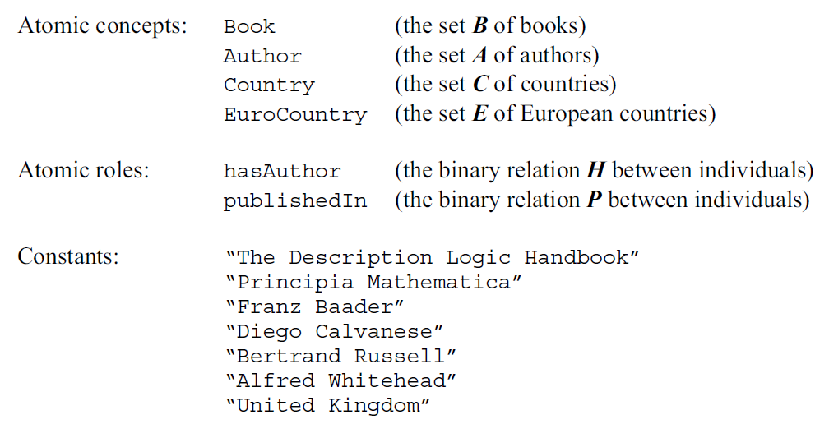
An Informal Example

Slide 12
An Informal Example
we cannot guarantee that H relates books to authors, and that P relates books to the countries where they were published. We can only say that H and P relate individuals to individuals, which is intrinsic to the semantics of description logic.
A complex concept, or a concept description, is an expression that constructs a new concept out of other concepts.
There are some illustration's how to define complex concepts that are gradually more sophisticated, using the alphabet and the intended interpretation for the atomic concepts and atomic roles (the sets B, A, C, E, H, and P).
In the explanations that follow each example (next slide), we use the intended interpretation or intended semantics of the symbols in the alphabet.

Slide 13
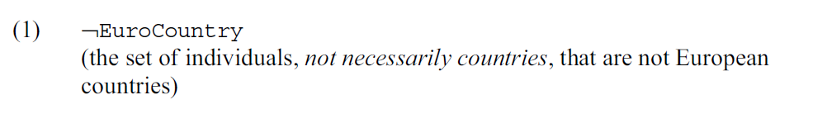
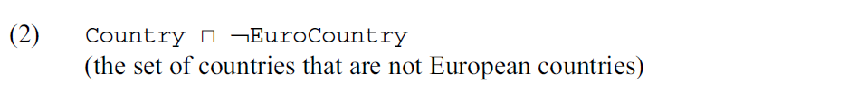
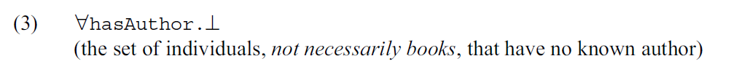
An Informal Example

Slide 14
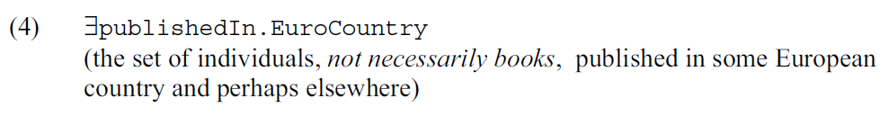
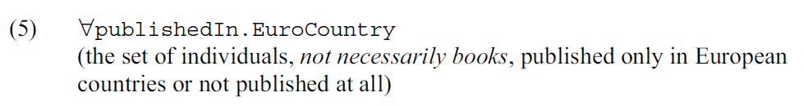
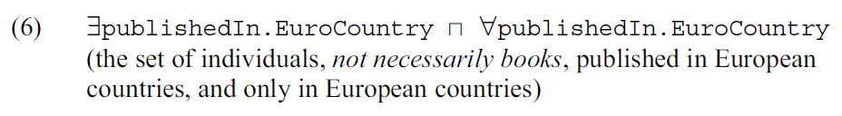
An Informal Example

Slide 15
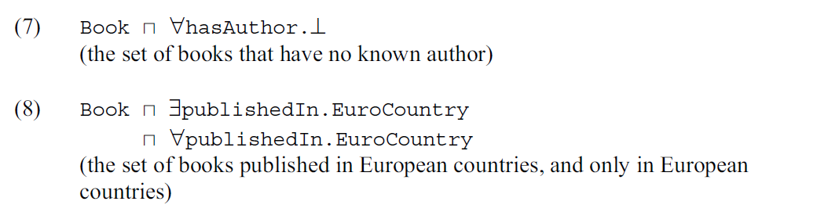
An Informal Example
An axiom introduces a new defined concept with the help of complex concepts. For example, the axioms in the next slide define the concepts: nonEuroCountry, anonymousBook, nonAnonymousBook, EuroBook, and nonEuroBook:

Slide 16
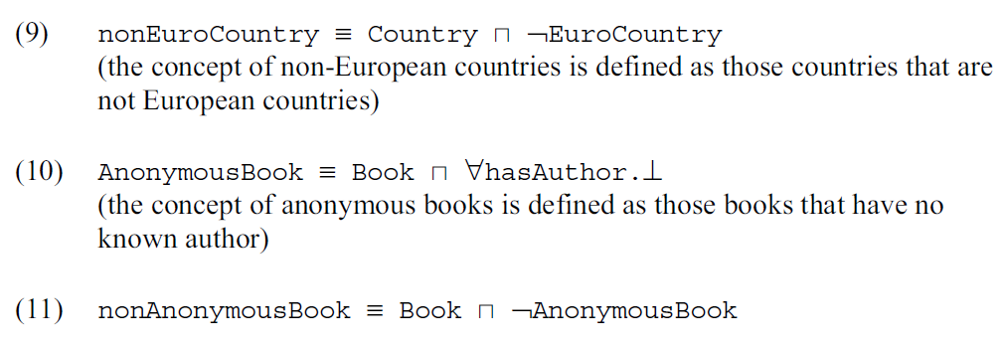
An Informal Example

Slide 17
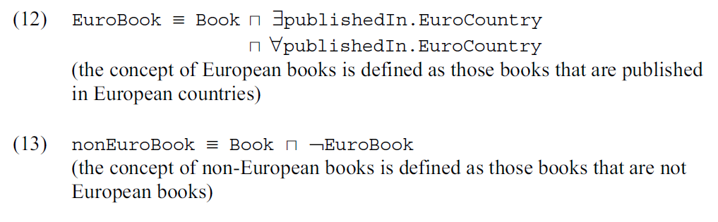

An Informal Example
An assertion either states that an individual belongs to a concept, or describes that individuals are related to each other by roles.

Slide 18
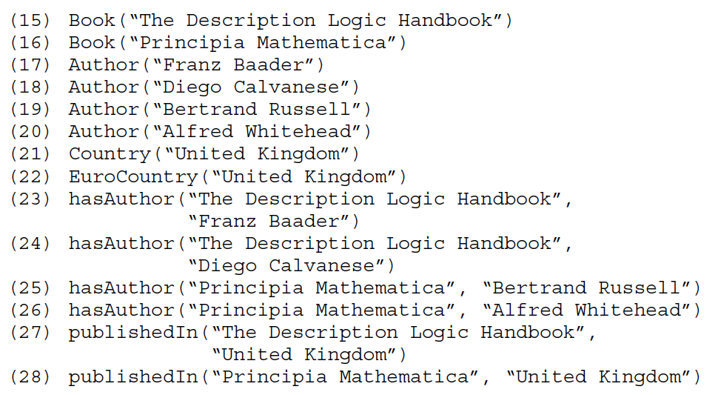

Slide 19
An Informal Example
A knowledge base is a set of axioms and assertions, written using a specific language.
The terminology, or TBox, of the knowledge base consists of the set of axioms that define new concepts.
The world description, assertional knowledge, or ABox of the knowledge base consists of the set of assertions.
The TBox expresses intentional knowledge, which is typically stable, whereas the ABox captures extensional knowledge, which changes as the world evolves.

Slide 20
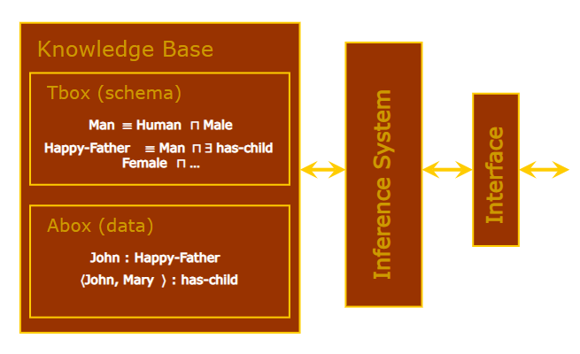

Slide 21

An Informal Example
We now informally exemplify how to deduce concept subsumptions and concept instantiations from the BOOKS knowledge base.
We stress that the examples are just indicative of what can be proved, but not of how the DL proof procedures operate.
We first prove that every country can be classified as either European or nonEuropean, but not both. we prove that:
The inclusion (29) follows directly from (9) and is equivalent to saying that no individual is both a European country and a non-European country. To prove (30),we establish the following sequence of equivalent complex concepts.

Slide 22
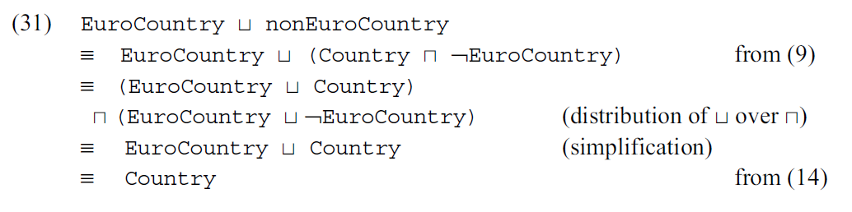

An Informal Example
We may likewise prove that every book is either anonymous or nonanonymous, but not both, using just (10) and (11). In this case, the definitions (10) and (11) already guarantee that AnonymousBook and nonAnonymousBook are subsumed by Book. That is, no inclusion similar to (14) is required. More precisely, we can prove that:

Slide 23
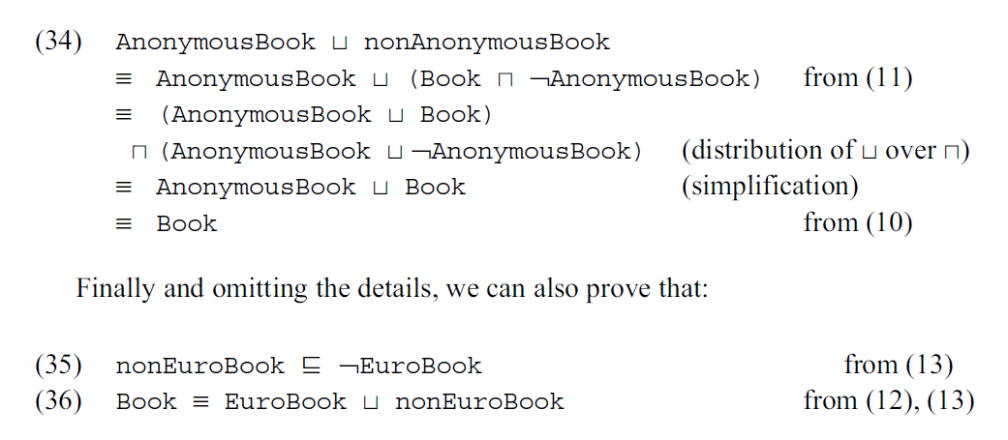
An Informal Example
The inclusion (32) follows directly from (11). To prove (33), we establish the following sequence of equivalent complex concepts.

Slide 24
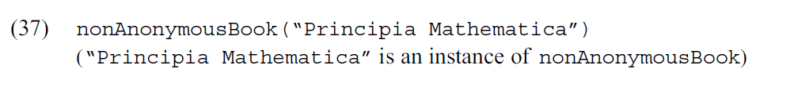
An Informal Example
We now turn to examples of concept instantiation. Suppose we want to prove that:

Slide 25
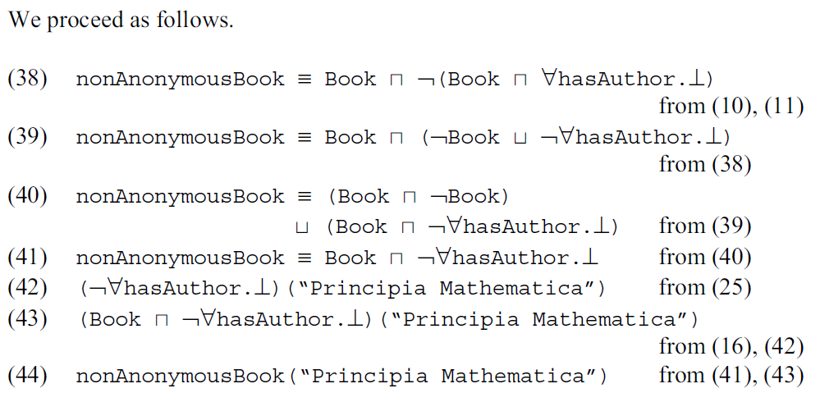
An Informal Example

Slide 26
The Family of Attributive Languages
Description languages differ by the collection of constructors they offer to define concept descriptions.
An attributive language L is characterized by an alphabet consisting of a set of atomic concepts, a set of atomic roles, and the special symbols T and ⊥, respectively called the universal concept and the bottom concept.
The set of concept descriptions of L is inductively defined as follows.

Slide 27
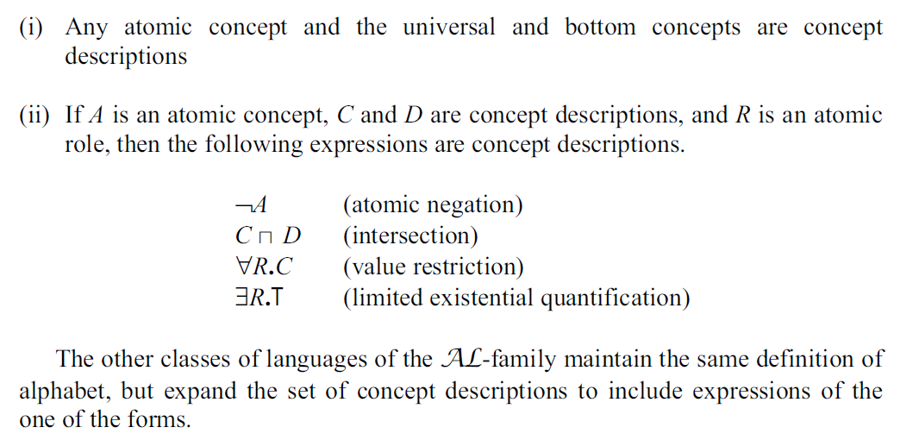
Concept Descriptions

Slide 28
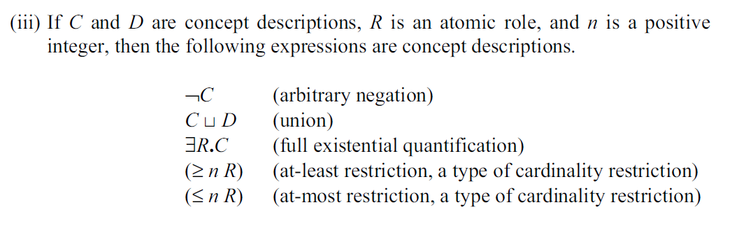
Concept Descriptions

Slide 29
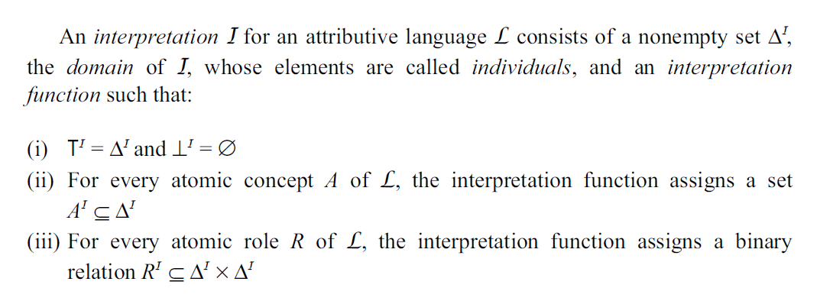
Concept Descriptions

Slide 30
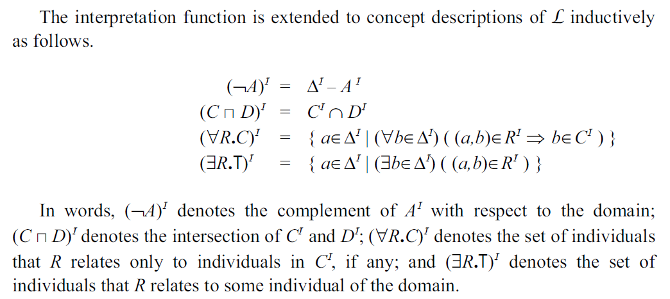
Concept Descriptions

Slide 31
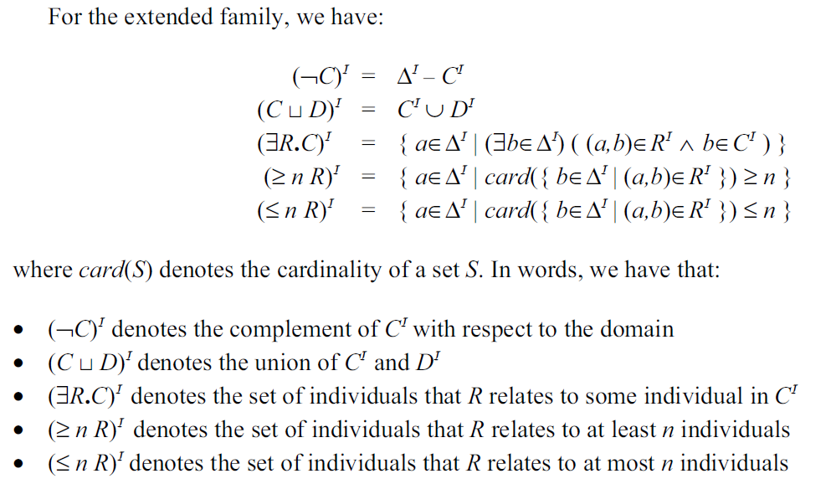
Concept Descriptions

Slide 32
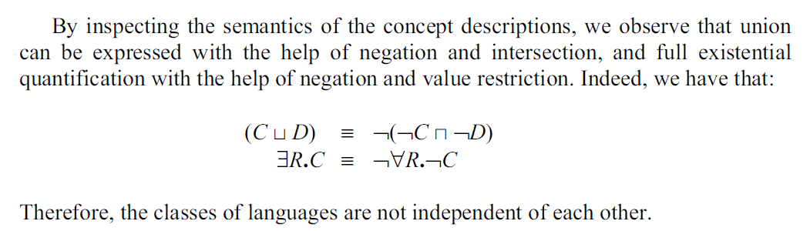
Concept Descriptions
We say that two concept descriptions C and D of L are equivalent, denoted C ≡ D, iff CI = DI , for all interpretations I of L. We say that two concept descriptions C and D of L are equivalent, denoted C ≡ D, iff CI = DI , for all interpretations I of L.

Slide 33
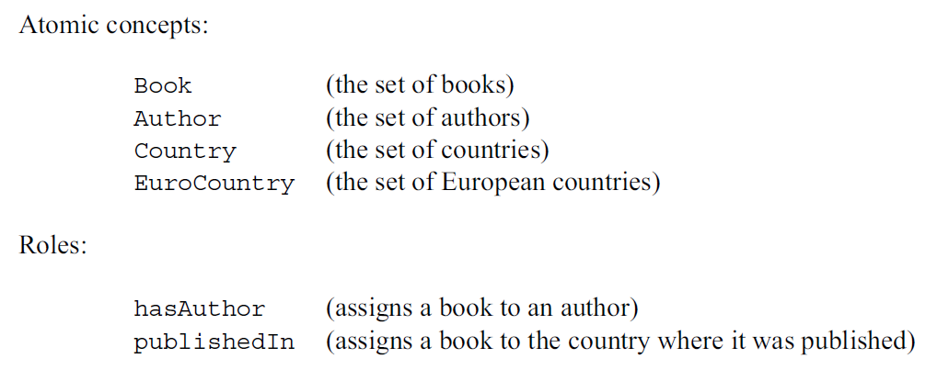
Concept Descriptions
As an example, consider the language P with the following alphabet:

Slide 34
The Family of Attributive Languages
Strictly speaking, we cannot guarantee that any interpretation I of P will be such that hasAuthorI assigns an individual in BookI to an individual in AuthorI.
That is, we cannot guarantee that hasAuthorI ⊆ BookI × AuthorI. A similar observation holds for publishedIn.
This is an intrinsic limitation of the semantics of description logic.
The family of attributive languages table is given in next slides.

Slide 35
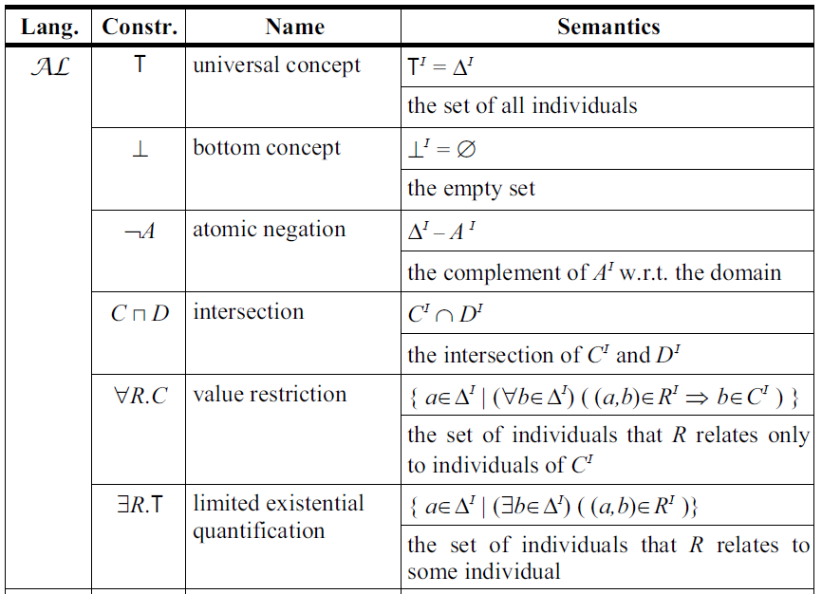

Slide 36
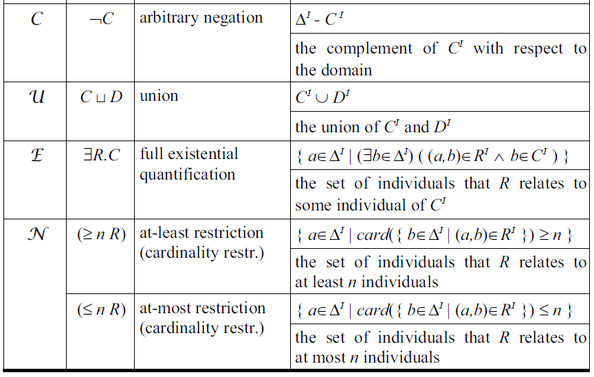

Slide 37
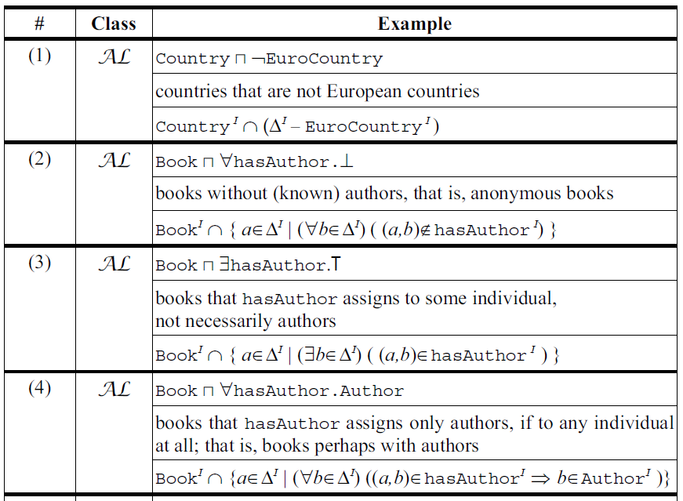

Slide 38
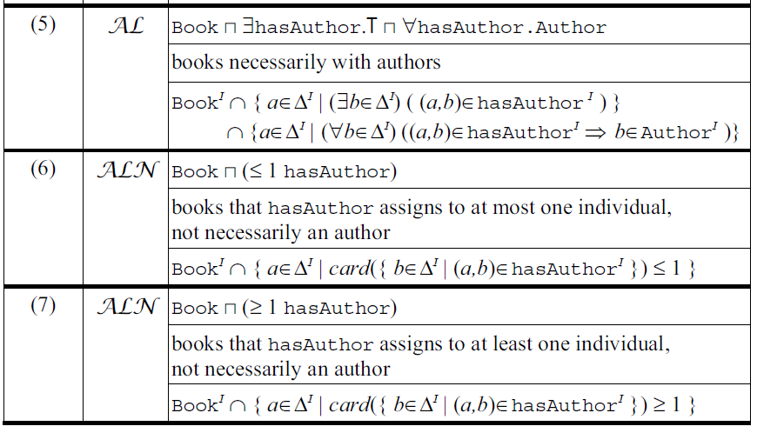

Slide 39
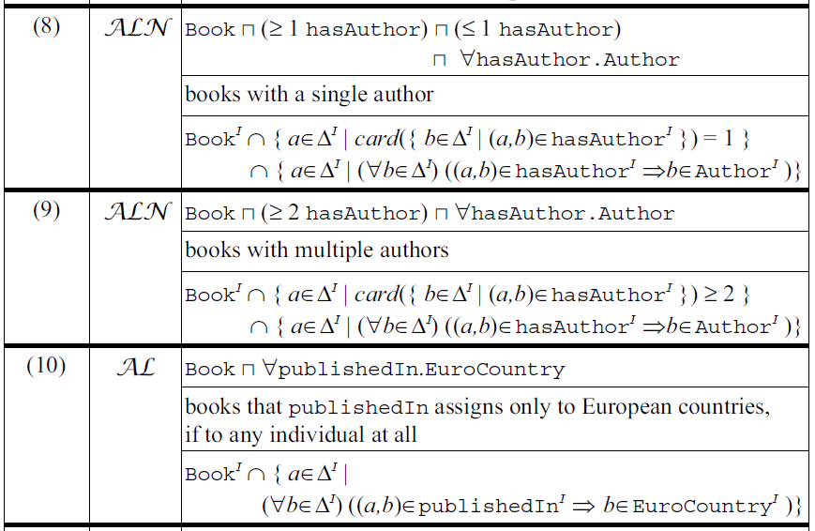

Slide 40
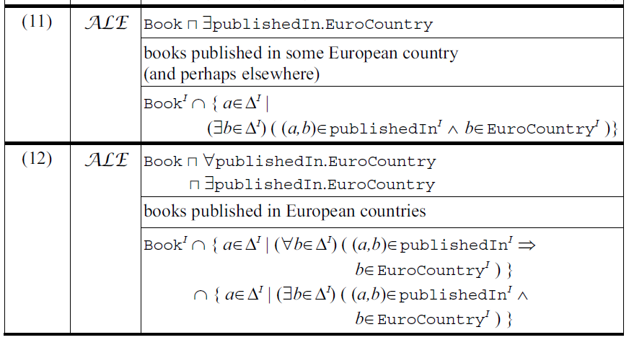

Slide 41
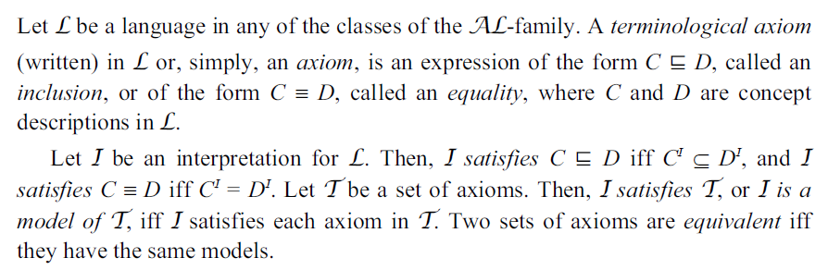
Terminologies

Slide 42
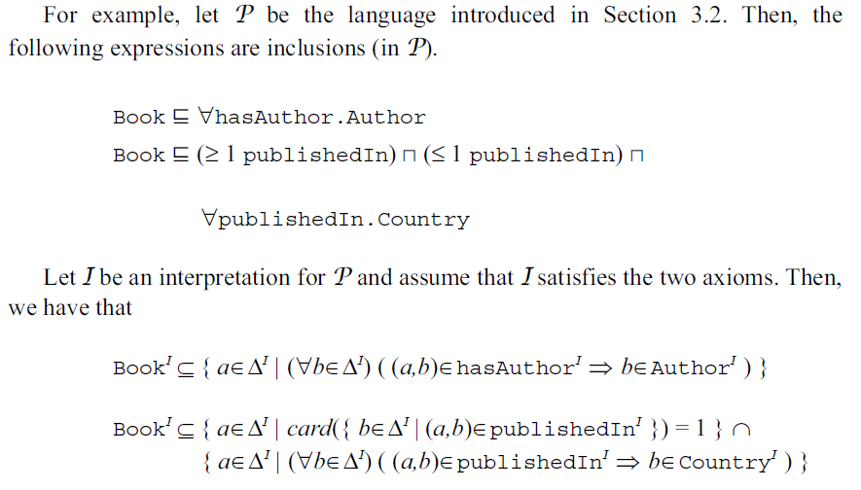
Terminologies

Slide 43
Terminologies
A definition (written) in L is an equality A ≡ D such that A is an atomic concept and D is a concept description of L.
A terminology or a TBox (written) in L is a set of definitions D such that, for any atomic concept A of L, there is at most one definition in D whose left-hand side is A, called the definition of A in D.
We may therefore partition (with respect to D) the atomic concepts of L into defined concepts (with respect to D) that appear in the left-hand side of the definitions in D and primitive concepts (with respect to D) that do not appear in the left-hand side of the definitions in D.
We say that a defined concept A directly uses an atomic concept B iff B occurs in the right-hand side of the definition of A.

Slide 44
Terminologies
We inductively define that A uses an atomic concept C iff A directly uses a defined concept B and B uses C.
A terminology is acyclic iff no defined concept uses itself; that is, the uses relationship is acyclic.
In acyclic terminologies, the interpretation of the defined concepts can be constructed from the interpretation of the primitive concepts, as expected. More precisely, let D be an acyclic terminology in L.
A base interpretation for L with respect to D is an interpretation I of L, except for the defined concepts (with respect to D). An extension of I is an interpretation J of L that has the same domain as I and which is identical to I in all primitive concepts and atomic roles.
It is possible to prove that, if D is an acyclic terminology in L, then every base interpretation for L with respect to D has a unique extension that is a model of D.

Slide 45
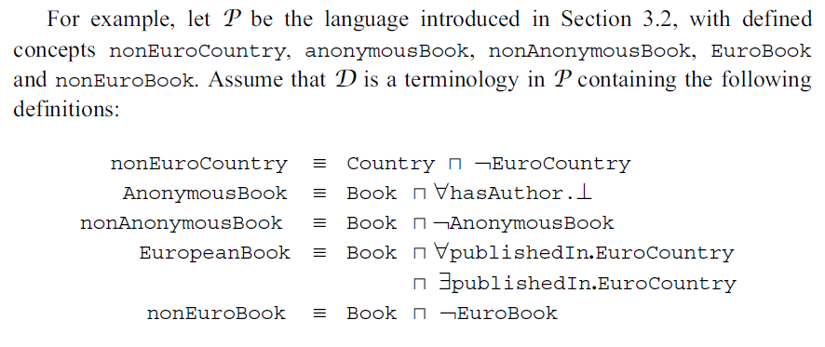
Terminologies

Slide 46
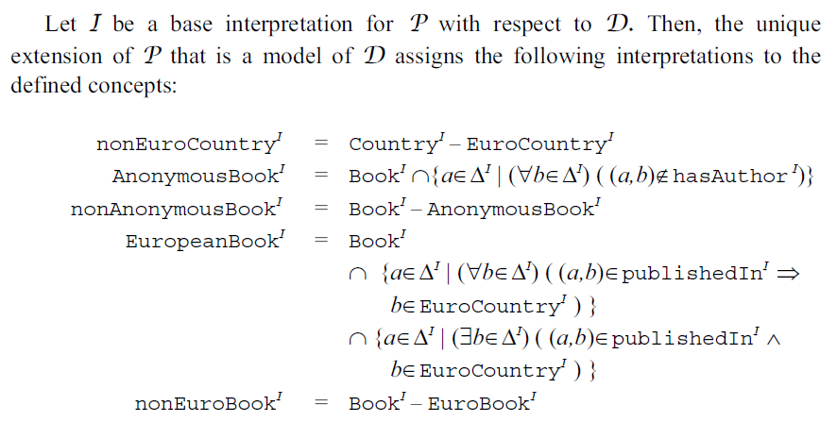
Terminologies

Slide 47
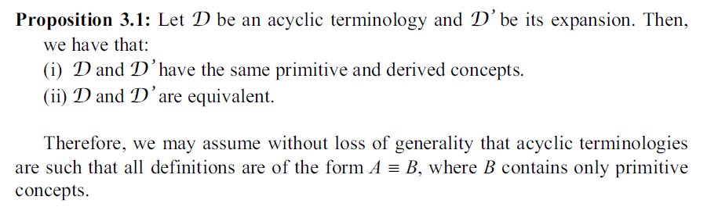
Terminologies

Slide 48
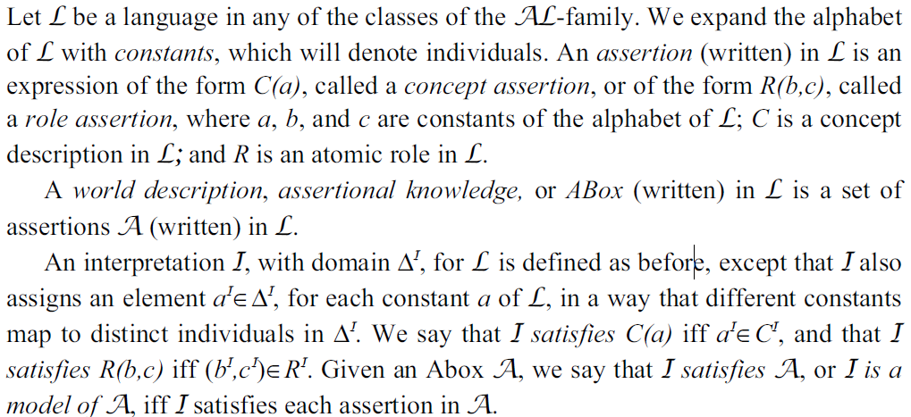
Assertions

Slide 49
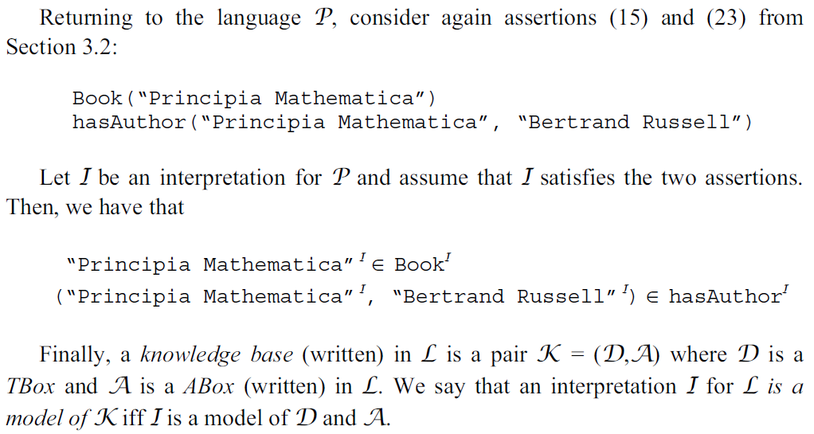
Assertions

Slide 50
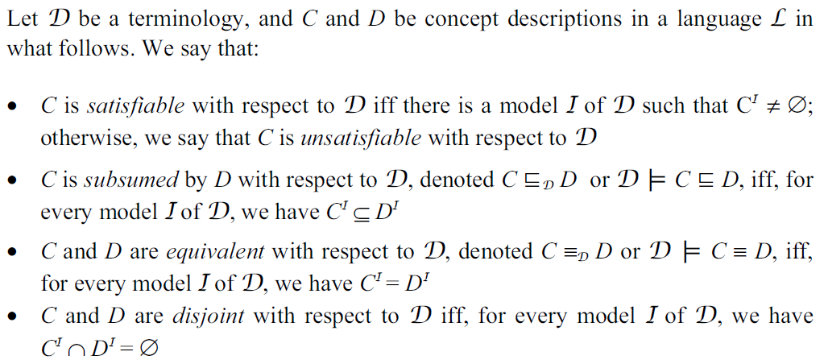
Inference Problems for Concept Descriptions

Slide 51
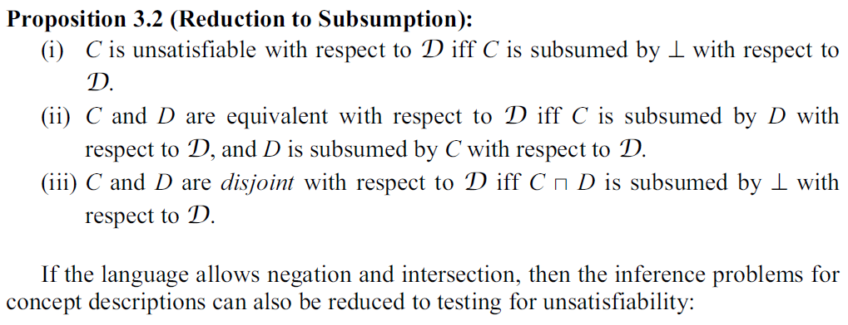
Inference Problems for Concept Descriptions

Slide 52
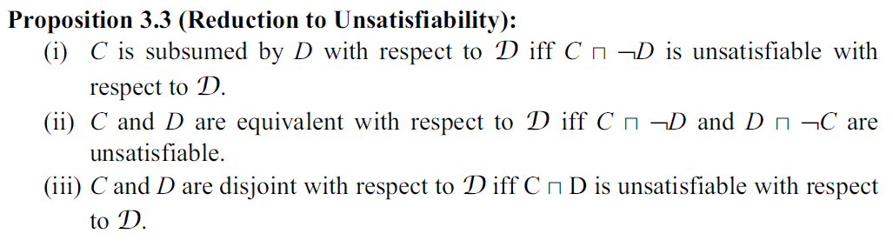
Inference Problems for Concept Descriptions

Slide 53
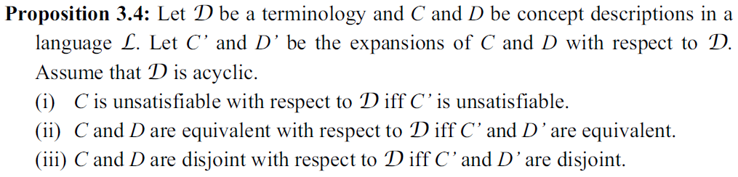
Inference Problems for Concept Descriptions

Slide 54
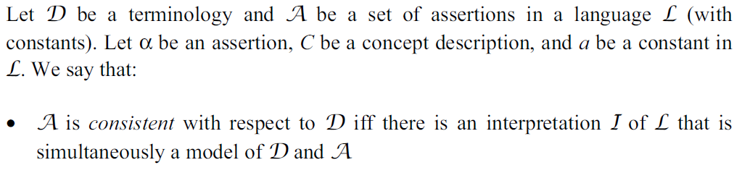
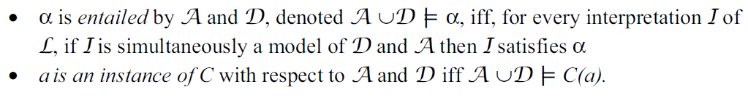
Inference Problems for Assertions

